Slide 1
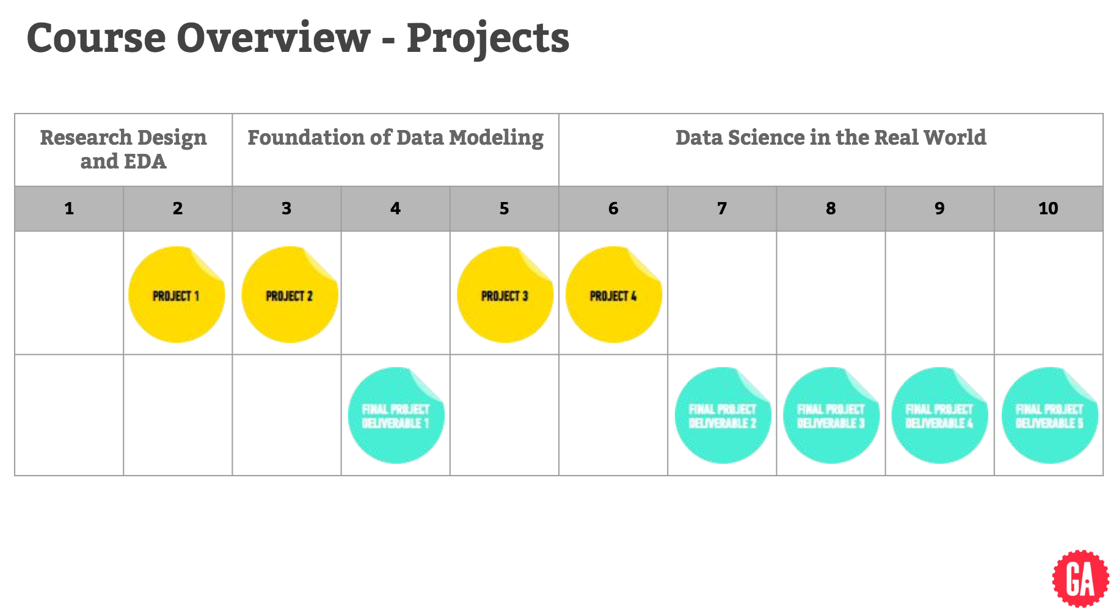
May 2 | May 9 | May 16 | May 23 | May 30 | June 6 | June 13 | June 20 | June 29 | July 6 | July 13?
May 4 | May 11 | May 18 | May 25 | June 1 | June 8 | June 14 | Jun 22 | July 5 | July 11

